Slide 2
Build tiered cloud storage in Microsoft Azure BRK3210
Vamshi Kommineni @vamshikommineni
Azure Storage Team

Slide 3
What we’ll cover today
Brief Introduction to Azure Storage
Overview of Azure Object (Blob) Storage
Scenarios
Working with Blob Storage
Key Concepts
Architecture
Blob Storage Design Patterns

Slide 4
Azure Storage Talks @ Ignite
Session ID | When/Where | Attend if you are interested in | Talk title
BRK2201 | Tuesday 9/27 10:45-12:00 C202 - C204 | Azure Storage Overview Storage Solutions: Backup and Recovery Hybrid Storage &Global Data Access | Dive into scenarios and customer success stories with Azure Storage
BRK3210 | Tuesday 9/27 12:30-1:45 B312 - B314 | Azure Object (Blob) Storage Overview Working with Blob Storage Blob Storage Design Patterns | Build tiered cloud storage in Microsoft Azure
BRK3209 | Wednesday 9/28 10:45-12:00 B312 - B314 | Overview, Deep Dive and roadmap for Azure Disks Azure Files | Optimize IaaS VM Storage using Azure Disks and Files
BRK3211 | Thursday 9/29 10:45-12:00 B304 - B305 | Azure Storage Security topics Control and data plane authorization Data Encryption – Client-side, in-transit and server-side | Secure your data in the cloud with Microsoft Azure Storage

Slide 5
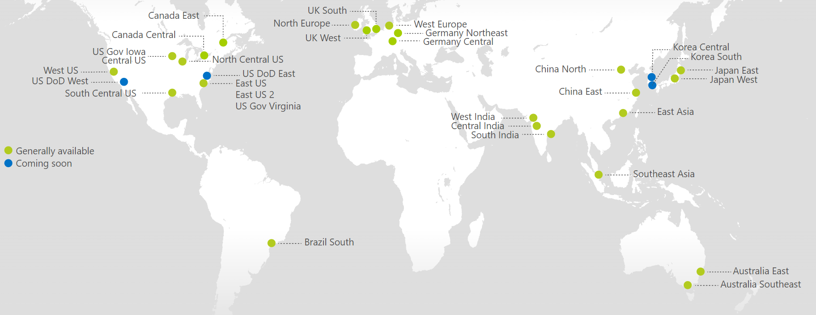
Azure Scale
30 GA, 4 coming soon – Storage is available in every region
Notes:
We almost always start our presentations with this slide that shows the global scale of Azure. We have 30 regions in GA with 4 more announced which is more regions than AWS and Google combined. The relevance to Azure Storage is that we are the distributed file system underpinning this global presence. Storage is a foundational service that is available in every single region and our own infrastructure services in any new region require storage along with compute and networking as the base substrate to start up and offer the Azure suite of services.

Slide 6
Azure Storage
Foundational Building Block of Azure
Azure Services: SQL Data Warehouse, HDInsight, Data Lake Store, Event Hubs, IoT Hubs…
Microsoft Services: Office 365, OneDrive, XBox, Skype…
Hyper Scale
>120 Trillion Objects, >19 million transactions per second
Durable
Never lose your data. Multiple redundancy options. Automatic data checks
Secure
Encryption at Rest. Client side Encryption. Integration with KeyVault
Highly Available
Fault tolerance to hardware/software issues. Automatic load balancing
Open
REST API, Open sourced Client Libraries – .NET, Java, C++, Python, Node.js, iOS, Android, Xamarin…
Hybrid
Extensive partner ecosystem. Azure Stack for private/hosted clouds.
Notes:
In addition, Azure Storage is also used by every Azure service directly or indirectly for data persistence and by nearly every MS services including O365 and Skype for Business on the enterprise side and OneDrive, Xbox and Skype on the consumer front
The Storage services have a number of capabilities that are common across the board…let’s go through each of them briefly.
Hyper Scale: In 60 min, ~6B net new objects, ~70B transactions, ~2.5PB of data ingressed/egressed. In 1 yr: 52T net new objects, 613T transactions, 21EB of data…but more than that since the growth rate is also increasing over time.
Durable: Multiple replicas with failure recovery and no data loss. One-click options for redundancy, including automatic geo-replication. Checksums and CRC scrubbing to protect against data corruption and bit rot
Secure: Wide variety of security options ranging from encryption at rest to easy client side encryption including key management with Azure KeyVault: Azure’s HSM as a service
Highly Available: We recover from disk, node and rack level failures without you having to worry about it. We scale up and down dynamically based on amount of read/write traffic to your data
Open: We are platform agnostic and have support for using Storage from a wide variety of languages and development environments including .Net, Java, Python and Node.js as well as mobile platforms including iOS, Android and Xamarin
Hybrid:
We have a wide variety of partners that integrate with Azure Storage including backup companies like Commvault and Veritas that provide on-prem to cloud backup and storage companies like NetApp and EMC that provide hybrid storage on-ramps from their arrays to Azure Storage. We work with a number of cloud first storage startups like Panzura, Nasuni, Softnas, Talon and more. In addition we have our own first party services that provide tiered experiences from servers including Azure Backup, Azure Site Recovery and StorSimple

Slide 7
Azure Storage Services
IaaS
PaaS
Virtual machines
Existing frameworks
Web and mobile
Microservices
Serverless Compute
Storage
Networking
Disks
Persistent disks for Azure IaaS VMs
Premium Storage Disks option: SSD based, high IOPS, low latency
Files
Fully Managed File Shares in the Cloud
SMB and REST access
“Lift and shift” legacy apps
Objects
Highly scalable, REST based cloud object store
Block Blobs: Sequential file I/O
Cool Tier Available
Page Blobs: Random-write pattern data
Append Blobs
Tables
Massive auto-scaling NoSQL store
Dynamic scaling based on load
Scale to PBs of table data
Fast key/value lookups
Queues
Reliable queues at scale for cloud services
Decouple and scale components
Message visibility timeout and update message to protect against unreliable dequeuers
Built on a unified Distributed Storage System
Durability, Encryption at Rest, Strongly Consistent Replication, Fault Tolerance, Auto Load-Balancing
Notes:
Cloud services and cloud usage are broadly defined as existing across infrastructure services or IaaS and higher layer platform services or PaaS. The Azure Storage services span both categories.
On the IaaS side we provide single instance storage for VMs in the form of our Disks service and SMB shared storage which we call Azure Files.
On the PaaS side we provide an unstructured object store called the Blob Storage service which offers Exabyte scale and the ability to store trillions of objects across different tiers within the cloud. Our current cloud object storage tiers are hot storage for higher performance and frequently accessed data and cool storage for active archives. In addition to unstructured data, we also have the NoSQL Tables service for semi-structured and structured data and the Queues service for reliable intra and inter-service communication.

Slide 8
Azure Storage Durability
Typically >300mi
Typically >300mi
Async
Async
Primary
Secondary
Primary
Secondary
LRS
3 replicas, 1 region
Protect against disk, node, rack failures
Write is ack’d when all replicas are committed
Superior to dual-parity RAID
GRS
6 replicas, 2 regions (3/region)
Protects against major regional disasters
Asynchronous to secondary
RA-GRS
GRS + Read access to secondary
Separate secondary endpoint
RPO delay to secondary can be queried
Strong consistency, checksums/CRC and background scrubbing to preserve data integrity

Slide 9
Azure Object (Blob) Storage

Slide 10
What is the Blob Storage Service?
Object Storage: Store and serve unstructured data
App and Web scale data
Big Data from IoT, Genomics, etc.
Backups and Archive
Key Features
Store PBs of data
Durable – Choose level of durability: LRS, ZRS, GRS
Highly Available - 99.9% SLA, 99.99% for reads (RA-GRS)
Strongly consistent
Dynamically scale up on bandwidth and TPS
Cost Effective

Slide 11
Blob Storage: Ideal for PaaS
Why?
Limitless Scale
Globally accessible
Cost Efficient
Scenarios for application data:
Live Data Repository
Active or Deep Archive
Big Data Analytics

Slide 12

Carmax.com on Azure
Brandon Linton
Solution Architect, carmax.com
Online Systems Platform Team
@brlinton
Notes:
Connect
On-call rotation
Intro self – how CarMax does high availability with carmax.com and vehicle images
Hope – you can apply some of these ideas to help make your own systems more capable and resilient

Slide 13
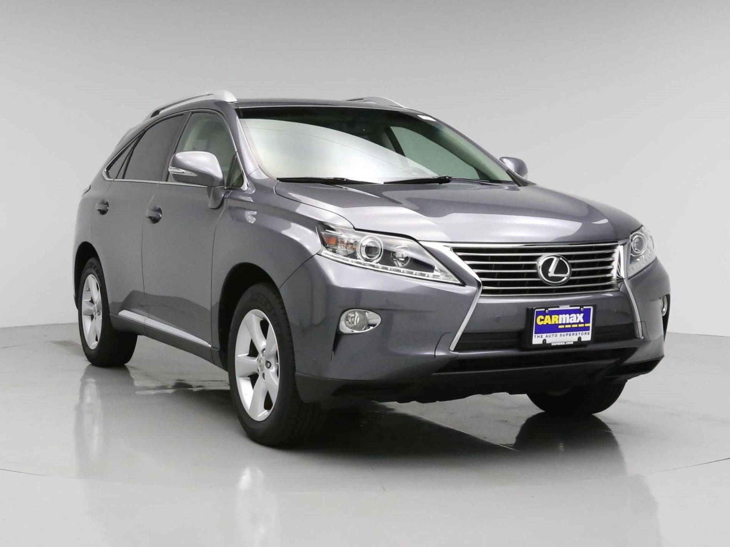
DEMO
carmax.com Images
Notes:
DEMO
carmax.com Home Page, Search Page, Car Page, vehicle image URL
Largest nationwide used car retailer
160+ stores
Transitioning to an ecommerce company
Images really help connect customers to the car, sell much faster
-- Notes --
DEMO
– Goal – showcase use of images on the site
Images help customers fall in love with the car, most people won’t contact us about a car if there aren’t images (hit that home, it’s core to the business)
Show search funnel (home page, search results with image slider, car page images with web inspector to get image URL, play with image URL to show resizing)
Emphasize how important that is since the site is fully responsive, demo that
Use Charlotte or Orlando (7106, 7107)
Or outdoor photos (Richmond 7101 or 7108)
My store nearest: https://www.carmax.com/search#Distance=store&SortKey=8&Zip=28227

Slide 14

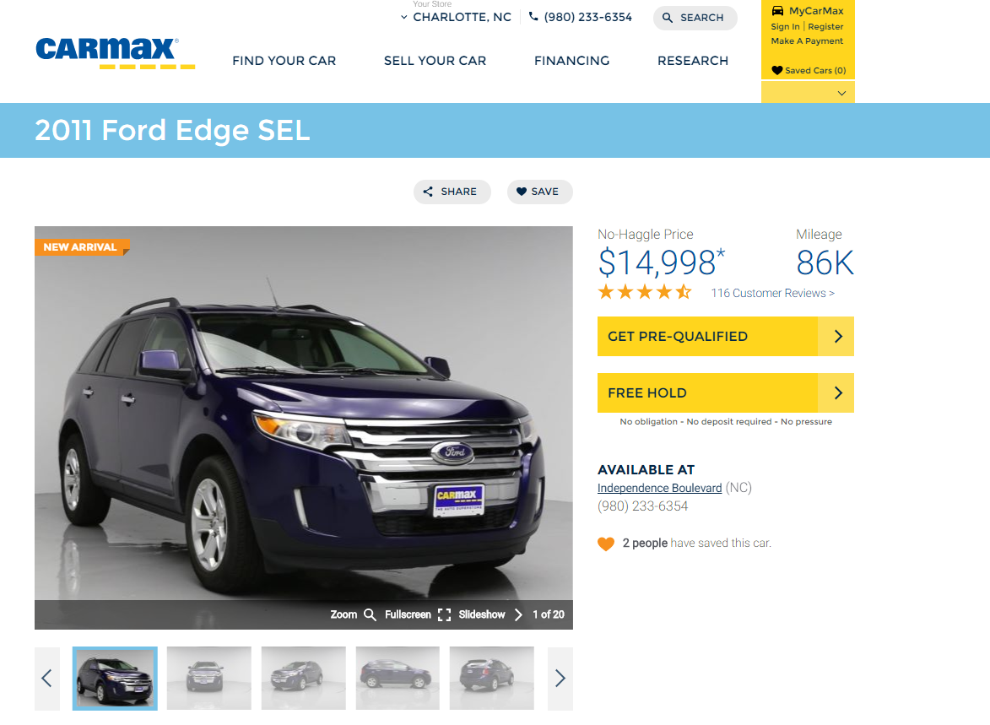

Original Vehicle Images Architecture
On-prem
img3.carmax.com
Image SAN
Stores
Desktop Uploader
Image Services
Notes:
Original Architecture
Overview of the system (store => vim to multiple sizes, database URLs, SAN)
Three big problems: capacity, availability, and capability
Fixed capacity: , HD images, outbound bandwidth, compression
Slow copy: New SAN w/in datacenter slow, took days to copy to another data center
Low Availability – wasn’t in another datacenter!
Process overview
Sales associate takes pictures of the car
Special application sends to services that make copies of the image at ~6 sizes, uploads to a 4TB SAN
IIS website in front of the SAN with simple static file handling, and URLs come from the database generated during resizing
Now we’re at 13TB
HD images rollout was a huge driver of storage growth
Challenges
Started to run into hard 4TB limit on the SAN, couldn’t resize it, needed to stand up a new SAN which was not only expensive, but slow to copy
Even slower to copy to another datacenter for DR purposes
Bandwidth
Needed sizes for celebration wall, mobile
New sizes were a huge pain
We had 6 different sizes 160, 300, 400, 600, 700, 1080
Database had to know the photos to generate the URLs (GUIDs)
URLs not convention-based

Slide 15





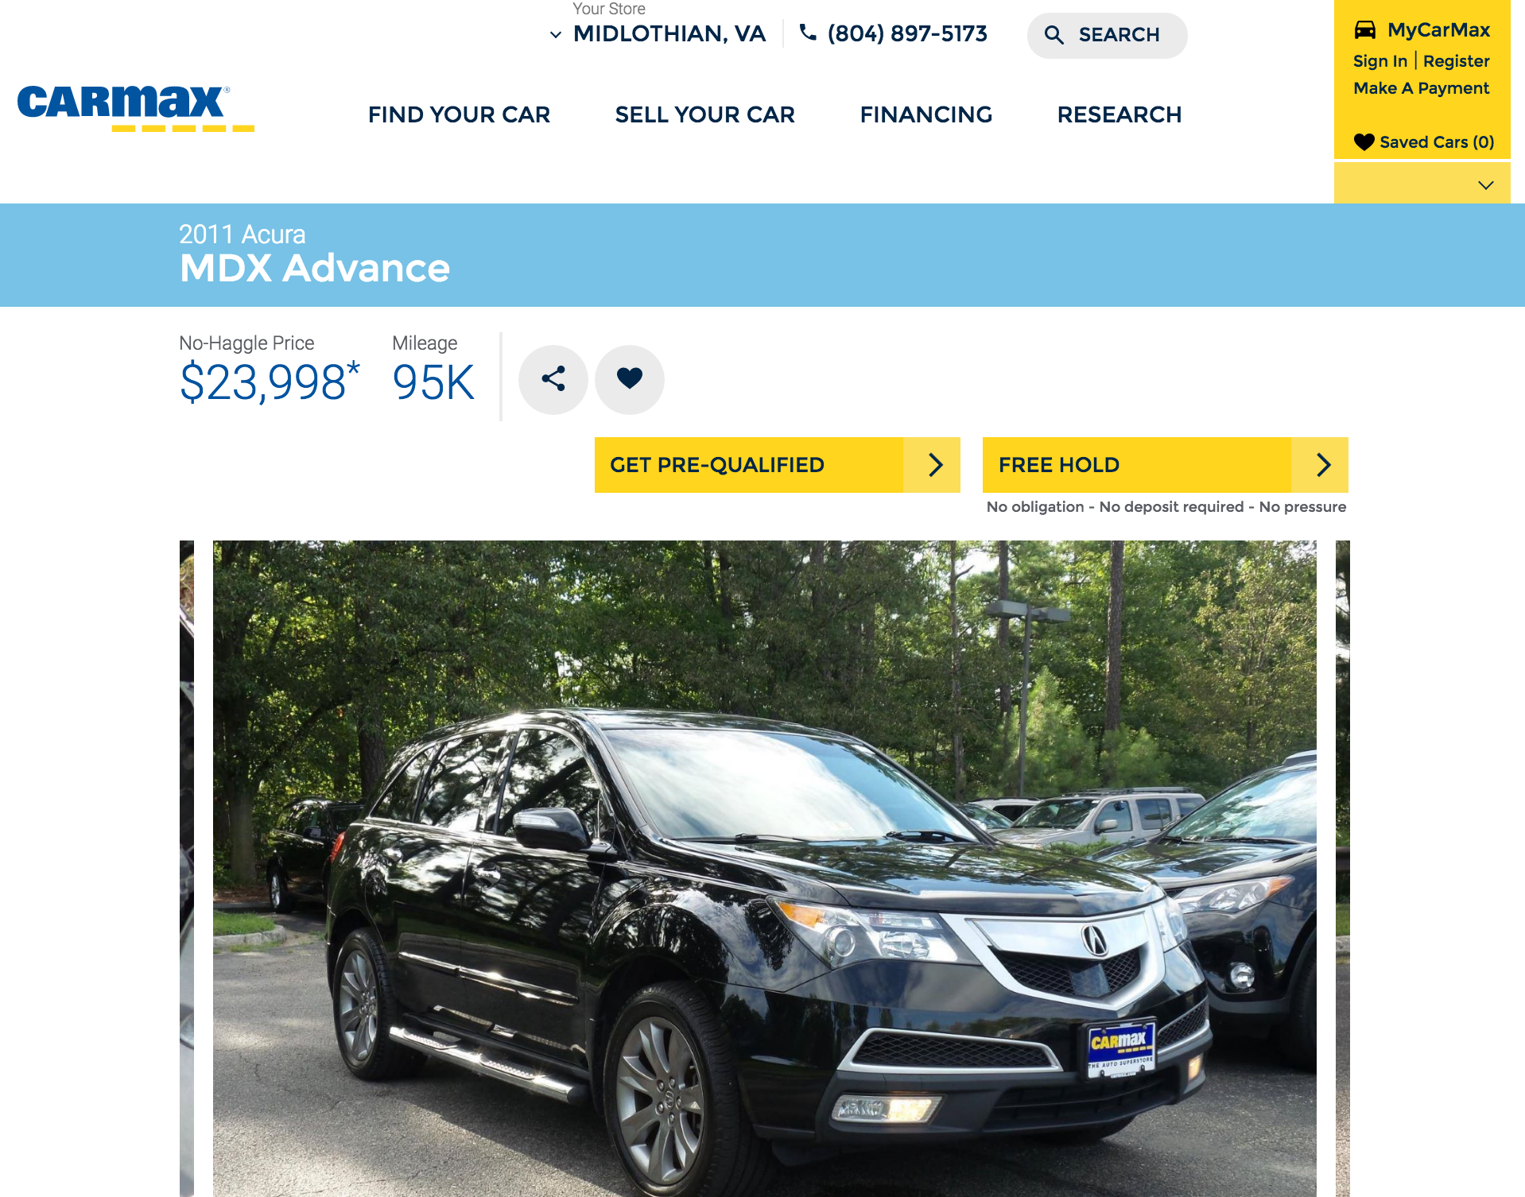


Vehicle Images Architecture with Azure Storage
East US
Azure Web App
Blob Storage
RA-GRS
West US
img2.carmax.com
Traffic Manager
On-prem
Azure Web App
Image Services
Blob Storage
Notes:
NEED TO BE AT 5:00 MARK
NEW ARCHITECTURE
Process same up until VIM
VIM takes original image and goes straight to blob storage with it
Three huge advantages: effectively limitless capacity, fast, automatic replication, and high availability – here’s how we solved those three challenges
Active / Active
Autoscaling, scheduled scaling with over 3 billion requests per month
TRANSITION
This brought our company into the cloud, and we loved it so much…

Slide 16






Moving carmax.com to Azure
www.carmax.com
West US
On-prem
East US
api.carmax.com
ARR
Online API
Central US
Notes:
Carmax.com ARCHITECTURE
Lifted the web tier into Azure
Again, huge benefits: Active Active, list resources
Azure Caching anecdote
Active / Active
Resource templates
Use PowerShell to orchestrate pushing to the staging slot of cloud services, run automated load tests, browser based acceptance tests
Talk back to on-prem services through reverse proxy (ARR) and will ultimately do that through ExpressRoute
Three Big Benefits:
Active / Active
Increased capability: caching tier, traffic manager by performance, Application Insights, provisioning times are drastically reduced
Continuous Delivery – build orchestration through PowerShell, automated browser based acceptance testing, load testing, Azure storage opens up some new deployment scenarios

Slide 17
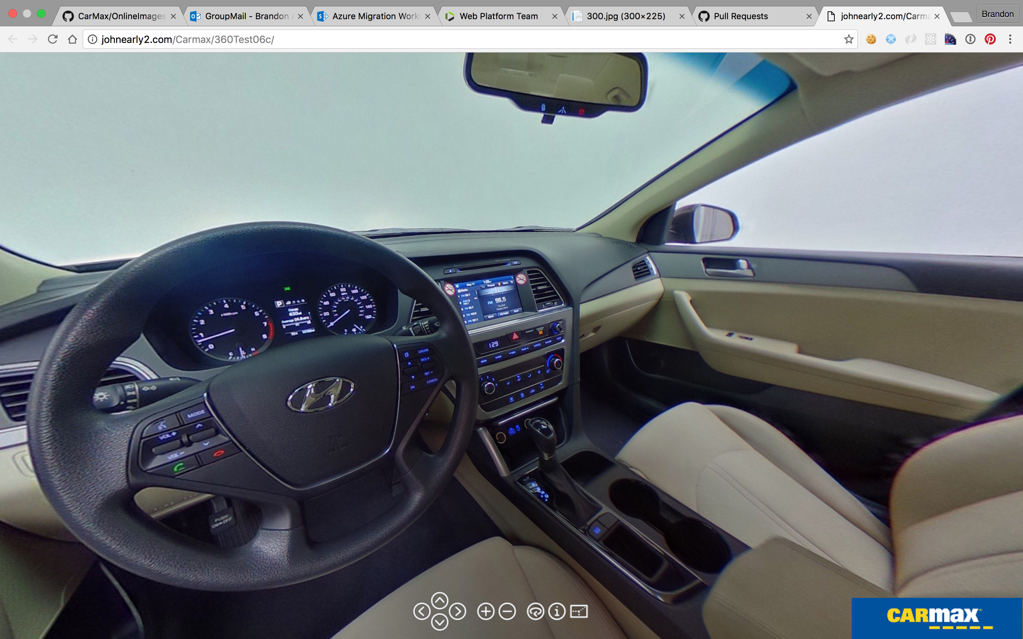
Next for Images
360 Degree Photos
Video
Image Metadata
Long-lived images to cool storage
Notes:
CLOSING SLIDE
We want to continue to invest in these technologies since the return has been so high
I mentioned I’m on our Platform team, but there are product teams that constantly work to improve many areas of the site: (finance, home delivery, SEO)
We want to pull apart some of our more monolithic services and design highly available services for product teams to own and innovate on end-to-end
For images specifically, we’re working on leveraging metadata stored with each image to start to group and present photos in interesting ways on the website (like exterior vs. interior photos)
And we also continue to get demand for keeping images longer and longer as we move out further with our ownership and loyalty programs so customers can see the original pictures of their cars long after purchase – cool storage is a great candidate for that
So I hope this has given you all some ideas of how you can improve the capability and resiliency of your own software systems using Azure and Azure storage
We are a product
Azure image metadata – set up smart gallery
Could be more generic
Gallery service
Dream – I’m taking photos and uploading them at the same time
Video and 360 images
Metadata that links to related photos (dings, etc)
360 images, videosmetadatascriptingquery storage metadatapurging?imageresizer.net
Owners, loyalty experience with long-lived images
10 days, to 30 days, to a year

Slide 18
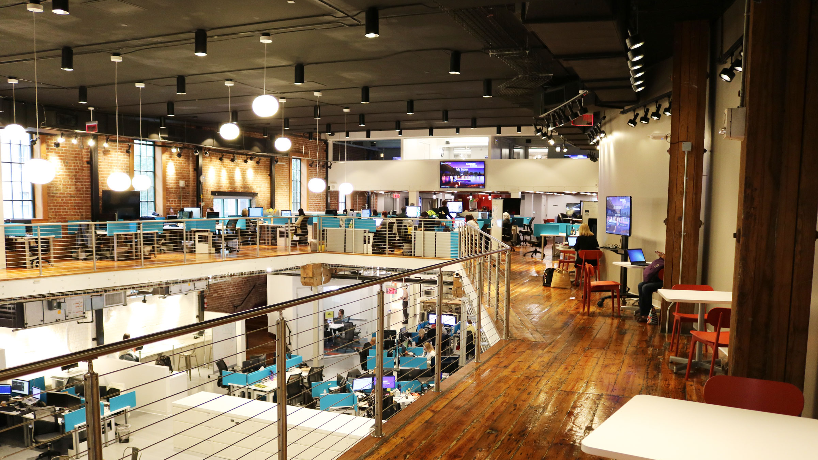


Next for Teams
Cultural Shift across CarMax
Broader adoption in product teams
Monoliths to Microservices
CarMax Shockoe
Richmond, VA
Notes:
CLOSING SLIDE
“It’s not just about vehicle images”
We want to continue to invest in these technologies since the return has been so high
I mentioned I’m on our Platform team, but there are product teams that constantly work to improve many areas of the site: (finance, home delivery, SEO)
We want to pull apart some of our more monolithic services and design highly available services for product teams to own and innovate on end-to-end
For images specifically, we’re working on leveraging metadata stored with each image to start to group and present photos in interesting ways on the website (like exterior vs. exterior photos)
And we also continue to get demand for keeping images longer and longer as we move out further with our ownership and loyalty programs so customers can see the original pictures of their cars long after purchase – cool storage is a great candidate for that
So I hope this has given you all some ideas of how you can improve the capability and resiliency of your own software systems using Azure and Azure storage
We are a product
Azure image metadata – set up smart gallery
Could be more generic
Gallery service
Dream – I’m taking photos and uploading them at the same time
Video and 360 images
Metadata that links to related photos (dings, etc)
360 images, videosmetadatascriptingquery storage metadatapurging?imageresizer.net
Owners, loyalty experience with long-lived images
10 days, to 30 days, to a year

Slide 19
Blob Storage: Deep Dive

Slide 20
Types of Blobs
Block Blobs
Most object storage scenarios
Documents, images, video, etc.
Append Blobs
Multi-writer append only scenarios
Logging, Big Data Analytics output
Page Blobs
Page aligned random reads and writes
IaaS Disks, Event Hub, Block level backup
Image.jpg
Block 1
Block 2
Block 3
Block 4
Block 1
Block 2
Block 3
Block 4
512
1024
1536
2048
Sparse File
512 byte aligned
2560
Notes:
Block Blobs:
For most object storage needs
Optimized for sequential access
Each blob is made up of blocks
Append Blobs:
Similar to Block Blobs
Can only append blocks to the end of the blob
Optimized for multi-writer append scenarios (logging, etc.)
Page Blobs:
Optimized for random reads and writes
Collection of 512 byte pages
Support for sparse files
Focus of the rest of this talk is Block Blobs

Slide 21
Blob Storage Concepts
Microsoft Azure
Subscription 1
Storage Account 1
Container 1
Subscription 2
Storage Account 2
Container 2
Blobs
Subscription...n
Storage Account...n
Container…n
Contoso
http://<StorageAccount>.blob.core.windows.net/<Container>/<Blob>
Notes:
Review architecture.
If you take only one thing away from this talk it is this. WHAT you decide to use for your Partition Key is critically important to having a successful table design. The reason for is that in Azure your Partition Key determines how we group your data, how we dynamically allocate resources to load balance your data, and if you will be able to do “Batch” transactions against that data.
A good Partition key allows us to scale out your service and give you 1000s of transactions per second without any additional work on your part.
So what makes a good Partition key? Azure Storage is a range based partitioning system so if your keys are spread out over the Lexi-graphical key space that gives us the best change to observe your query patterns and scale out your data set appropriately.
In a relational database such as SQL Server, your clustered index determines how your data is stored on disk. A common pattern is to use an INT for your Primary Key, however in Azure Table Storage that would be considered and anti-pattern and not enable your application to scale.
We’ve just scratched the surface here, there is a lot more detail in the Azure Tables Design Guide which will go into depth on choosing the right keys, building composite keys for query flexibility, and avoiding bad patterns.

Slide 22
Demo
Block Blobs: Getting Started with Code and Tools

Slide 23
Blob Names
http://foo.blob.core.windows.net/images/2016/September/Annika.jpg
Account Name: 3-24 characters, lower case only
Container Name: 3-63 characters, lower case only
Blob Name: 1-1024 characters, case sensitive
Virtual directories within blob namespace

Slide 24
Blob Structure
Standard Properties
Blobtype: BlockBlob|PageBlob|AppendBlob
Etag & Last-Modified – Used for conditional operations
Content-Length & Content-MD5 – Size of blob in bytes and checksum
User Defined Metadata
Up to 8KB of unique names and associated values (valid HTTP headers)
No partial updates – Retrieve, then set
Can set on containers as well
Blob Data
Up to 200GB per blob

Slide 25
Uploading Block Blobs
PutBlob
Single REST call for data up to 64MB in size
New PutBlob on existing object name will replace it
PutBlock/PutBlockList
Split data to be uploaded into blocks (up to 4MB each)
Efficient Continuation and Retry
Parallel, out of order uploads
Allows for intra-object de-duplication
Block Blobs are mutable
New PutBlock calls to add to object or replace selective blocks
Combine existing and new blocks to create a modified object
Image.jpg
(<64 MB)
REST Calls
PutBlob(Image.jpg)
Movie.mp4 (1 GB)
REST Calls
name = “Movie.mp4”;
PutBlock(BL001);
PutBlock(BL002);
…………
PutBlock(BLN00);
PutBlockList(
BL001,…,BL00N);
BL001
BL002
BL003
BLN00

Slide 26
Downloading and Copying Blobs
GetBlob
Returns blob properties and metadata in addition to data
Checksums in response allow data integrity validation
Range reads are supported
Can build parallel downloading of large blobs
CopyBlob
Full copy – Uncommitted blocks (and snapshots) are discarded
Copies can complete asynchronously
CopyId to check progress or abort Copy
Within an account, copies are fast
Copy from other external sources – e.g. – web sites, S3 etc

Slide 27
Listing and Deleting Blobs
ListBlobs
Container level operation
Up to 5000 blobs at a time, with NextMarker
Filtering – Prefix for “Begins with”
Traversing – Delimiter returns list of prefixes for use with filtering
DeleteBlob
Consider DeleteContainer for large numbers of Blobs

Slide 28
Client Libraries
Simplify working with Azure Storage Services
Implement convenient features
Automatic chunking into blocks
Parallel uploads
Retry policies on failures
Client side encryption
…

Slide 29
Versioning
Snapshots
Read only copy of a blob at a point in time
Same name as blob with a datetime stamp
Can be read, copied/restored or deleted
CopyBlob to make a write-able new blob from a snapshot
CopyBlob to restore a snapshot over the current version
Snapshots are not copied with a normal CopyBlob operation
Blob Deletion requires deletion of all snapshots
Notes:
Can delete all snapshots of a bloc

Slide 30
Concurrency
Optimistic concurrency – Timestamps/ETags
Timestamp based – If-Modified-Since and If-UnModified-Since
ETag based – If-Match and If-None-Match
Conditional update with supplied Timestamp or ETag will fail if conditions not met
Pessimistic Concurrency - Leases
Lease Blob for exclusive write and delete access
15-60s lease duration (can be renewed) or infinite lease (locks)
Can change lease id to acquire ownership in a chain/workflow
Can also acquire on containers to prevent container deletion
Last Writer wins
https://azure.microsoft.com/en-us/blog/managing-concurrency-in-microsoft-azure-storage-2/
https://msdn.microsoft.com/en-us/library/dd179371.aspx
Notes:
Can delete all snapshots of a bloc

Slide 31
Woodard & Curran Using Panzura and Blob Storage to foster collaboration
Kenneth Danila
Director, Information Systems, Woodard & Curran
kdanila@woodardcurran.com

Slide 32
Background (History)
1995 Problem:
Small engineering company with team of engineers and designers working on Boston’s Big Dig project
Synchronizing base files within the design team
Massive file sizes (1 Mb+) were outstripping our collaborative technology:
The floppy disk
1995 Solution:
Build a LAN! Network the workstations together; double one as a file server
Problem solved!

Slide 33
Background (History)
1997 Problem:
Need engineers and designers from different sites to collaborate on the same drawing sets
1997 Solution:
Build a WAN! 56k frame relay!
Problem solved!
Later in 1997 Problem:
Too slow.
Later in 1997 Solution:
More bandwidth! Problem Solved!

Slide 34
Background (History)
1998 Problem:
Too slow!
1998 Solution:
More bandwidth! Problem Solved!
1999 Problem:
Too slow!
1999 Solution:
More bandwidth! Problem Solved!

Slide 35
Background (History)
2001 Problem:
Too slow!
2001 Solution:
More bandwidth! Problem Solved!
2002 Problem:
Too slow!
2002 Solution:
More bandwidth! Problem Solved!
2005 Problem:
Too slow!
2005 Solution:
More bandwidth! Problem Solved!
2007 Problem:
Too slow!
2007 Solution:
More bandwidth! Problem Solved!
2010 Problem:
Too slow!
2010 Solution:
More bandwidth! Problem Solved!

Slide 36
Today
Typical engineering network:
Expensive private WAN connections (MPLS, Metro Ethernet, etc.)
Expensive WAN accelerators
Serving large (100s+ Mb) unstructured data files off of expensive NAS devices
CAD, GIS, Orthophotography, etc.
Typical engineering problem:
Can’t collaborate across geographies
Not working with real-time data
Spending time synchronizing files
Too slow.

Slide 37
Woodard & Curran
900+ Engineers, Scientists, Operators, Administration
19 offices across the U.S.
Environmental and Civil Engineering, Plant Operations
One Company
Collaboration across geographies
Hire the right people, regardless of location, and integrate
Struggling with the same problem
Aging storage infrastructure, one NAS in every location: silos of storage
Expensive MPLS WAN
No longer meeting company’s needs

Slide 38
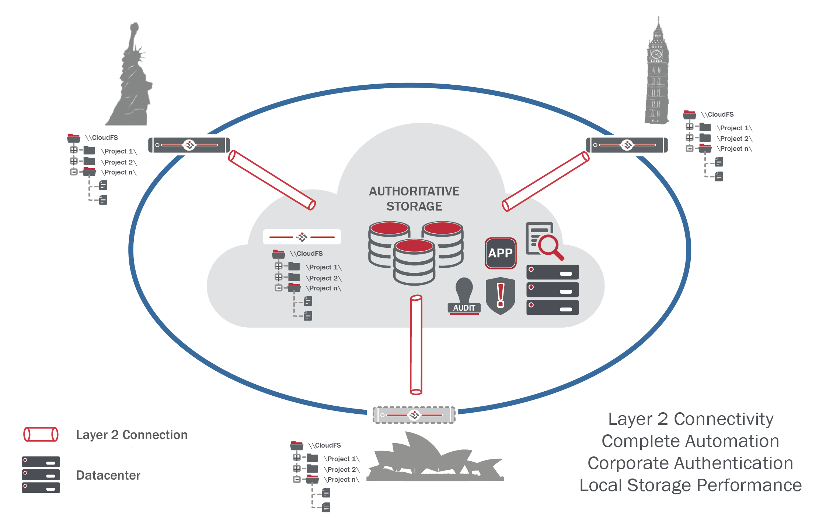
Panzura Cloud Integrated Datacenter
Centralized, geo-redundant storage via Azure
Multi-site locking
Block-level file updates
Deduplicated and compressed
DR Snapshots
Encrypted

Slide 39
Woodard & Curran’s Solution
Consolidated cloud storage with Panzura:
Migrated project data office-by-office to Panzura’s cloud, backed by Azure blob storage
Local cache appliances allow LAN speed on WAN files
As files are opened, locked across all other locations – no need for manual synchronization
Azure storage
Standard performance Geo-redundant storage
Currently in the classic (service manager) portal, available now in the resource manager portal
Connect via the Panzura interface

Slide 40
Benefits to Woodard & Curran
Improved collaboration
Multi-geographic teams now work at LAN speeds
Consolidated storage infrastructure
Replaced all NAS devices
Removed all WAN accelerators
Rebuilt WAN
Replaced copper DS3 MPLS with direct Internet access over fiber in all locations
Doubled speeds, yet saved $250,000 annually

Slide 41
Benefits to Woodard & Curran, cont’d
Predictable storage costs
We pay for what we use and reduce large, under-utilized capital outlays
No need to add expensive shelves of SSDs as existing storage is filled
Improved DR and BC
Regular, frequent snapshots
FIPS 140-2 certification + Reliability of secured Azure datacenters
Geographically redundant Azure blob storage
No cloud “lock-in”
Initially implemented on competing cloud storage
Used Panzura’s cloud agnostic model to migrate central storage repository to Azure

Slide 42
Solution: Hybrid Storage and Global Data Access
File or Block Access
Global Repository
Allows consolidation and centralization of data into the cloud
Accessible Anywhere
Edge Caching
Appliance (virtual or physical) in a location provides caching to address WAN throughput and latency issues
Global File Locking
For collaboration and workloads requiring concurrent access
Enhanced Security
AD, ACL
Storage

Slide 43





Featured Partner Solutions
Hybrid Storage and Global Data Access with Azure
Partner | Product Solution | Key Differentiators
 | Panzura Global NAS Appliance | SMB/NFS, global file sharing/locking, Compression and Deduplication, Extensive Snapshot Capabilities
 | Enterprise File Service | SMB/NFS, global file sharing/locking, global deduplication and compression, Extensive Snapshot Capabilities, Replication
 | CloudFAST | SMB, global file sharing/locking, intelligent file caching
 | SoftNAS Cloud NAS | Unified storage (iSCSI, SMB/NFS), Deduplication and Compression, Extensive Snapshot/Cloning Capabilities, Replication
 | CloudArray | iSCSI, SMB, NFS, Deduplication and Compression
 | DataPlatform | SMB, NFS, global data deduplication, snapshots, replication

Slide 44
Blob Storage: Design Patterns

Slide 45
Blob Storage Patterns
Data Movement
Delegated Authorization
Data Security
Full Text Search
Cloud Tiered Storage

Slide 46



Data Movement
AzCopy tool simplifies data migration at scale
Efficient means of copying millions of files – large or small
Includes journaling for reliability
Supports Blob Storage, Table Storage and File Storage
Data Movement library supports developers
Open source core framework from AzCopy
Enables custom applications to be developed
Storage Services
NAS
Storage Services

Slide 47





Delegated Authorization
SAS Tokens enable direct access by client apps
Supports least privilege principle
Removes the need to manage a data access layer
Mobile / IOT – Enable millions of untrusted clients
Web / Javascript – CORS + SAS enables website support
Token Issuer
Request / Renew
SAS Token
Storage Services
REST Request with
SAS token

Slide 48

Encryption at Rest
Blob Storage Service Encryption
Blob Storage Service automatically encrypts your data
SSL used to secure data sent to Storage Service
Microsoft manages all key management practices including compliance
What’s next: “Bring your own key” for server side encryption at rest
Application Encryption
Applications can encrypt data prior to sending to Storage Service
Includes support for KeyVault based key management
Supports Blob, Table and Queue storage
Available in .NET and Java Storage Client libraries
KeyVault
SSL
Storage Services

Slide 49
Full Text Search
Azure Search - Full-text search for Blobs (& Tables)
Index Data: Formats: PDF, Office, XML, ZIP, plain text, CSV, JSON
Index Metadata: Storage Metadata only or Storage & Custom Metadata
https://azure.microsoft.com/en-us/documentation/articles/search-howto-indexing-azure-blob-storage/

Slide 50
Cloud Tiered Storage
Two Tiers
Hot – for commonly used data
Cool – for rarely used data
API is 100% identical; similar throughput and latency
Durability options: LRS, GRS, RA-GRS
Availability: Cool - 99%, Hot - 99.9%. Higher for RA-GRS reads
Pricing to match your workload
Hot: Lower access prices for frequent use
Cool: Lower storage prices for high volume
Switch account tiers as needed
No charge for Hot to Cool switch
Future – Object level switch with automatic policy based management
Blob REST API
Blob Storage Account
Hot Tier
2.4₵/GB/mo
No R/W cost
Per Tx cost
Blob Storage Account
Cool Tier
1₵/GB/mo
1₵/GB Reads
0.25₵/GB Writes
2x per Tx cost
Account level conversion
Future – object level, policy
Notes:
Up level the text to emphasize sameness, cost, etc.
Don’t specify numbers

Slide 51
Seminole County Public Schools NetApp® AltaVault™ and Blob Storage for Backups
Kurt Springman
Sr. Manager, NetApp

Slide 52
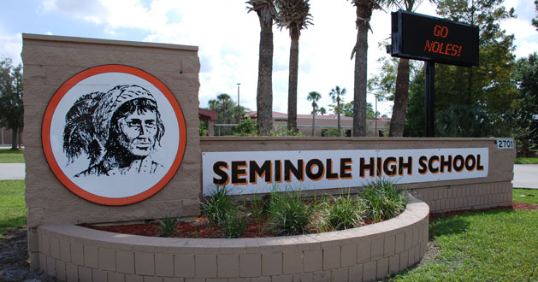

Seminole County Public Schools
Florida’s highest performing large school district
9 high schools, 12 middle, 36 elementary (60,000 students).
IT Environment
~250 servers, ~11 IT Staff.
IT systems for HR, Finance, Payroll, Student system, etc.
Challenge: Backup and Recovery
Tape backups shipped offsite, which was complex, expensive and slow.
Personnel needed to travel out of state to do a test recovery.
Labor intensive process to test a single recovery job, e.g. “print one payroll check”.
Notes:
- Emphasize the size of the district
- Add animation

Slide 53

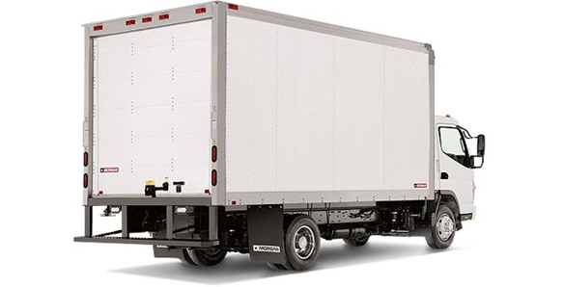



Backup Process
Backup to tape, shipped on trucks, stored in caves…

Slide 54

Restore? Reverse the Process…
Cave to truck to tape drive…

Slide 55

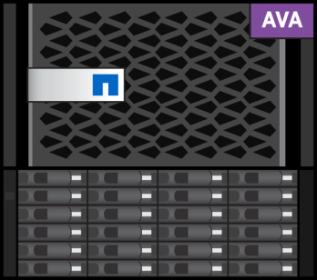
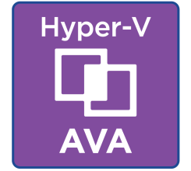

AltaVault ecosystem for Azure - Archiving
Any leading backup software
or Microsoft SQL Server
Supports:
Cool Storage and
Microsoft Azure Government
NetApp AltaVault Cloud-Integrated Storage
Primary
Storage
Azure API
Blob Storage
Seamlessly integrates into existing infrastructure
Deduplicates, compresses, and encrypts
Caches recent backups locally, “vaults” everything to Azure
Stores data in Azure

Slide 56
AltaVault ecosystem for Azure – Restore/DR
Any leading backup software
or Microsoft SQL Server
Supports:
Cool Storage and
Microsoft Azure Government
NetApp AltaVault Cloud-Integrated Storage
Primary
Storage
Azure API
Blob Storage
Seamlessly integrates into existing infrastructure
Uncompressed and de-encrypted
Individual file or data set download from Azure to AltaVault
Encrypted/ Compressed data in Azure

Slide 57
Secondary Data Center – Restore/DR
Any leading backup software
or Microsoft SQL Server
Supports:
Cool Storage and
Microsoft Azure Government
NetApp AltaVault Cloud-Integrated Storage
Primary
Storage
Azure API
Blob Storage
“key” copied from Primary site AVA
Seamlessly integrates into existing infrastructure
Uncompressed and de-encrypted
Individual file or data set download from Azure to AltaVault
Encrypted/ Compressed data in Azure

Slide 58

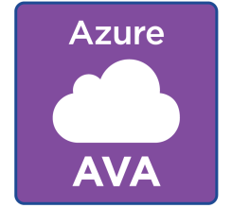

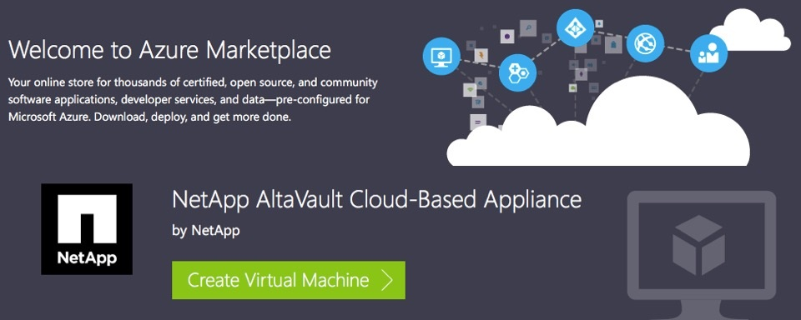
Azure as a Secondary Data Center
v
Microsoft Azure
Any leading backup software
or Microsoft SQL Server
NetApp AltaVault Cloud-Integrated Storage
Azure API
Azure Compute Resources
Blob Storage
“key” copied from Primary site AVA
Notes:
Buy for the hour. Test the restore each week and test by paying by the hour.
Arrow connects to azure compute

Slide 59






AltaVault for Azure
Cloud Integrated Storage Appliance
Seamlessly integrates into existing infrastructure.
Deduplication, compression, and encryption.
Caches recent backups locally, vaults to Azure.
Supports Hot and Cool tiers of Azure Blob Storage.
Use cloud virtual appliance for cloud restores and disaster recovery.
Hot and Cool Storage
AltaVault Cloud VA
Any leading backup software or Microsoft SQL Server
AltaVault appliances
On-premises data center

Slide 60

Customer Benefits with AltaVault
Quick Onboarding
No change to existing backup products, architecture or methodology.
Retire Tape Drive solution
Reduce cost and complexity (AVA400 48TB, under $50,000).
Customer estimates 80% cost savings over tape, along with freed up staff time.
Achieved 18:1 deduplication ratio: Longer local retention, quick replication to Azure.
The customer now has 13 TB of archive data in Azure Storage.
Faster Backups and Restores
Much easier to test restores.
Single file recovery from cloud to production very quickly.
Can even rehydrate fully functional VMs in Azure for alternative DR.

Slide 61
AltaVault for Azure
Features
Get started in 30 minutes with Azure.
Encrypts, Dedupes, Compresses.
Turnkey integration with Azure Storage.
Hardware or Software appliance.
Restore locally, remotely or to Azure.
Benefits
Reduce costs by up to 90%.
Access to data instantly.
Fast, convenient, reliable.
Can restore in Azure cloud.
“The minute production systems were up, we realized the NetApp platform was light-years ahead of what we had before.”
Tom Condo, Supervisor of IS Operations, Seminole County Public Schools
cloud.netapp.com/storage-solutions-for-azure
cloud.netapp.com/AltaVault
Kurt.Springman@netapp.com John.Parker@netapp.com

Slide 62
Solution: Backup and Disaster Recovery
Backup
On-premises data
Cloud data and VMs
Target
Object storage directly
Ideal workload for cool storage
Virtual Backup Appliance
Disaster Recovery
Recover workloads in the cloud
Recover data to alternate sites
Migration
Move data into the cloud
DR
Storage
DR

Slide 63







Featured Partner Solutions
Providing Backup and Disaster Recovery with Azure
Partner | Product Solution | Key Workloads
 | CommVault | Backup and DR, Workload and Data Migration, Endpoint Data Protection
 | Veritas NetBackup (in Beta) | Backup and DR, Workload and Data Migration, Endpoint Data Protection
 | HPE Data Protector (October 9.08 release) HPE VM Explorer (September 6.2 release) | Backup and DR
 | NetApp AltaVault NetApp AltaVault Cloud-Based Appliance | Backup and DR
 | EMC Isilon CloudPools EMC Avamar Virtual Edition EMC Data Protection Suite CloudBoost | Hybrid Storage Backup and DR Long-Term Retention
 | Veeam® Cloud Connect™ for the Enterprise Veeam® Cloud Connect™ for Service Providers Veeam® Direct Restore to Azure | Backup and DR, Workload and Data Migration, Endpoint Data Protection
 | Dell Rapid Recovery Replication Target for Azure | Backup and DR, Archiving
 | DatacastleRed | Endpoint Data Protection
Notes:
Add in Veritas

Slide 64
Summary
Azure Blob Storage:
Highly Scalable, Durable and Available
Secure, Open and multi-platform
Hybrid
Partner Ecosystem for turnkey usage
Cost Effective
Documentation: http://aka.ms/AzureStorageDocs

